Slide 1
CSS Multiple Backgrounds
The Ins and Outs of having multiple backgrounds

Slide 2
Okay, What is it?
The ability to layer backgrounds on top of each other.

Slide 3
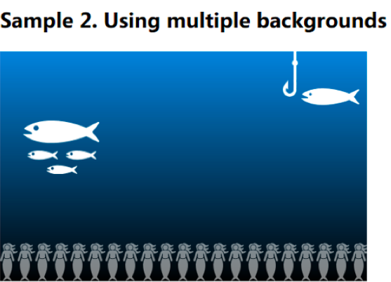
Example
Image from https://www.sitepoint.com/mastering-css3-multiple-backgrounds/

Slide 4
So, why should I use multiple backgrounds? WHAT BENEFIT!?
Reduces bandwidth by merging layers. (Less HTTP conversation)
Huge benefit of having the ability control individual layers of an image.
CSS3 is very flexible and versatile.

Slide 5
Okay, now that I know what it’s used for, how do I use it?
Little did you know that there are 8 attributes for “background”
background-color
background-image
background-position
background-size
background-repeat
background-origin
background-clip
background-attachment

Slide 6
Div
<div id/class=“”>
<div id/class=“”>
<div id/class-””></div>
</div>
</div
Or
<div id/class=“”></div>

Slide 7
Two ways of coding backgrounds
Now into CSS:
Long Hand
(Tradition of our fathers…)
Short Hand
Or even combine the two!

Slide 8
CSS 3 Multiple Backgrounds

Slide 9
Works Cited (Reference)
Sliding Doors (Tabs): http://alistapart.com/article/slidingdoors
http://www.css3.info/preview/multiple-backgrounds/ (Old paper, ribbon, decoration)

